Slide 1
Accounting Principles
Thirteenth Edition
Weygandt ● Kimmel ● Kieso
Chapter 1
Accounting in Action
This slide deck contains animations. Please disable animations if they cause issues with your device.

Slide 2
Chapter Outline
  Learning Objectives
L O 1 Identify the activities and users associated with accounting.
L O 2 State the accounting equation, and define its components.
L O 3 Analyze the effects of business transactions on the accounting equation.
L O 4 Describe the four financial statements and how they are prepared.

Slide 3
Accounting Activities and Users
Accounting consists of three activities
  Identification – Identify economic events (relevant to its business)
  Recording - Record, classify, and summarize
  Communication
    Prepare accounting reports
    Analyze and interpret the reported information

Slide 4
Accounting vs Bookkeeping
The accounting process includes the bookkeeping function.
Bookkeeping usually involves only the recording of economic events.
It is therefore just one part of the accounting process.
In total, accounting involves the entire process of identifying, recording, and communicating economic events.

Slide 5
Who Uses Accounting Data (1 of 2)
Internal Users
    Finance - Is cash sufficient to pay dividends to Microsoft stockholders?
    Marketing – What price should Apple charge for an iPad to maximize net income?
    Human Resources – Can General Motors afford to give its employees pay raises this year?
    Management - Which PepsiCo product line is the most profitable? Should any product lines be eliminated?

Slide 6
Who Uses Accounting Data (2 of 2)
External Users
    Investors
      Is General Electric earning satisfactory income?
      How does Disney compare in size and profitability with Time Warner?
    Creditors – Will United Airlines be able to pay its debts as they come due?

Slide 7
Measurement Principles
Generally Accepted Accounting Principles
The accounting profession has developed standards that are generally accepted and universally practiced. This common set of standards is called generally accepted accounting principles (GAAP). These standards indicate how to report economic events.
GAAP generally uses one of two measurement principles, the historical cost principle or the fair value principle.

Slide 8
Measurement Principles
Historical Cost Principle (or cost principle): Record assets at their cost prices
E.g., if GP purchases land for $300,000, the company initially reports it in its accounting records at $300,000. But what does GP do if, by the end of the next year, the fair value of the land has increased to $400,000? Under the historical cost principle, it continues to report the land at $300,000.
Fair Value Principle: Assets and liabilities should be reported at fair value (current market value).
Fair value information may be more useful than historical cost for certain types of assets and liabilities. For example, certain investment securities (shares) are reported at fair value because market price information is usually readily available for these types of assets.
Selection of which principle to follow generally relates to trade-offs between relevance and faithful representation.
Faithful representation means that the numbers and descriptions match what really existed or happened—they are factual. (historical cost principle)
Relevance means that financial information is capable of making a difference in a decision. (Fair value principle)
BOTTOM LINE: In general, most companies choose to use cost. Only in situations where assets are actively traded, such as investment securities/shares, do companies apply the fair value principle extensively.

Slide 9
Assumptions
Monetary Unit Assumption
Include in accounting records only transaction data that can be expressed in terms of money
Economic Entity Assumption
Activities of entity be kept separate and distinct from activities of its owner and all other economic entities

Slide 10
Forms of Business Ownership
Proprietorship
Owned by one person
Owner is often manager/operator
Owner receives any profits, suffers any losses, and is personally liable for all debts
Partnership
Owned by two or more persons
Often retail and service-type businesses
Generally unlimited personal liability
Partnership agreement
Corporation
Ownership divided into transferable shares of stock
Separate legal entity organized under state corporation law
Limited liability

Slide 11
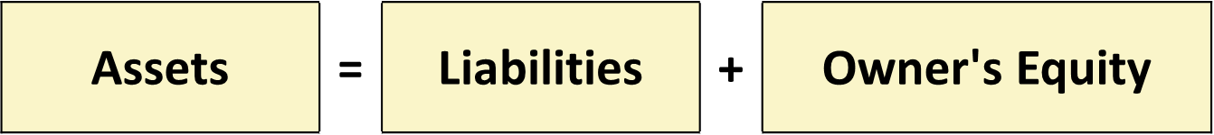
The Accounting Equation (1 of 6)
Basic Accounting Equation
Provides underlying framework for recording and summarizing economic events
Assets are claimed by either creditors or owners
If a business is liquidated, claims of creditors must be paid before ownership claims

Slide 12
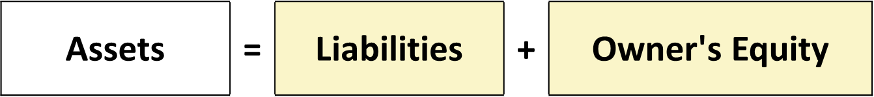
The Accounting Equation (2 of 6)
Assets
Resources a business owns
Provide future services or benefits
Cash, Supplies, Equipment, etc.

Slide 13
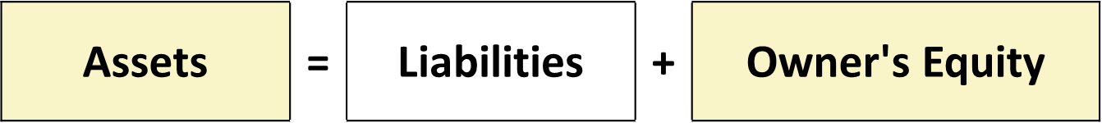
The Accounting Equation (3 of 6)
Liabilities
Claims against assets (debts and obligations)
Creditors (party to whom money is owed)
Accounts Payable, Notes Payable, Salaries and Wages Payable, etc.

Slide 14

The Accounting Equation (4 of 6)
Owner’s Equity
Ownership claim on total assets
Referred to as residual equity
Investment by owners and revenues increases owner's equity
Drawings and expenses decreases owner's equity

Slide 15
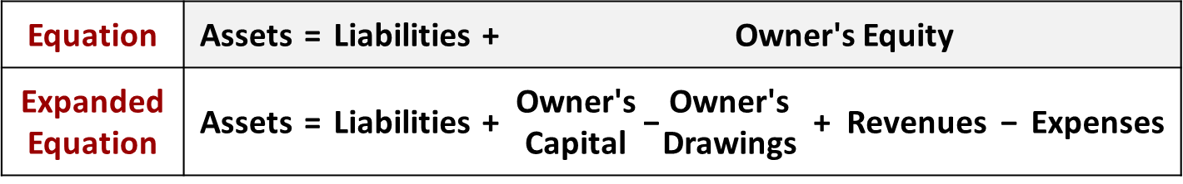
The Accounting Equation (5 of 6)
Increase in Owner’s Equity
Investment by Owner. Assets the owner puts into the business
Revenues. Increases in assets or decreases in liabilities resulting from sale of goods or performance of services in normal course of business

Slide 16
The Accounting Equation (6 of 6)
Decrease in Owner’s Equity
Drawings. A withdrawal of cash or other assets for personal use
Expenses. Cost of assets consumed or services used in the process of earning revenue

Slide 17
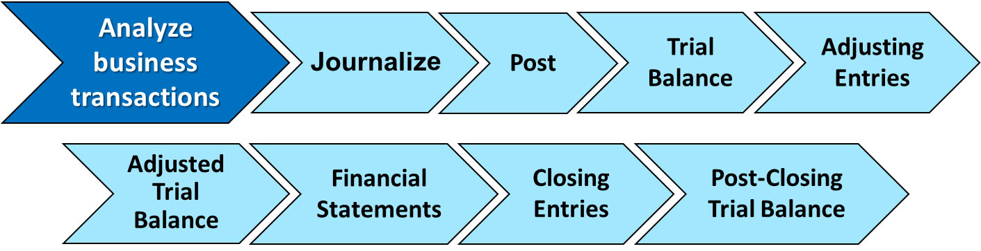
Analyzing Business Transactions (1 of 2)
Transactions are a business’s economic events recorded by accountants.
  May be external or internal
  Not all activities represent transactions
  Have a dual effect on the accounting equation

Slide 18
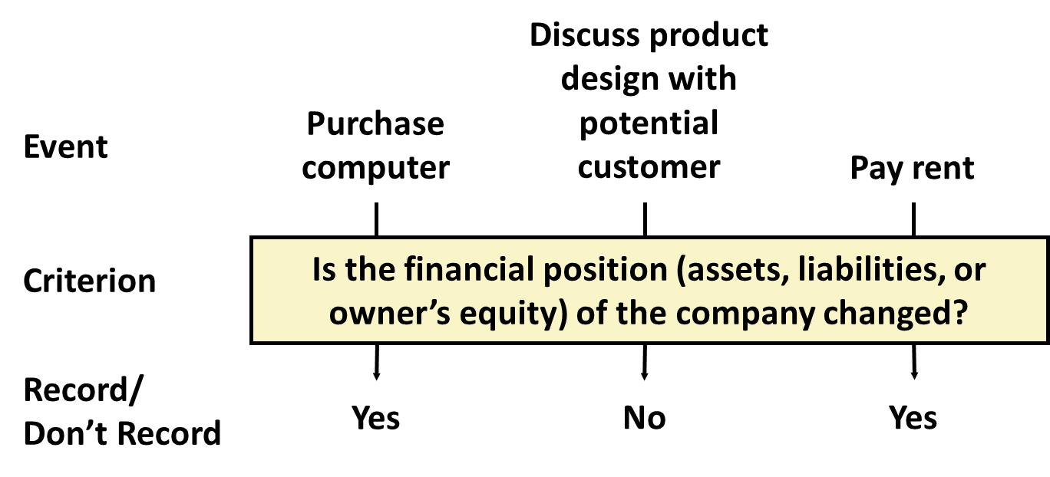
Analyzing Business Transactions (2 of 2)
Illustration: Are the following events recorded in the accounting records?

Slide 19
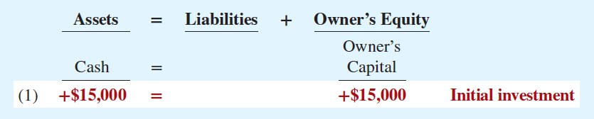
Transaction Analysis (1 of 10)
  Transaction 1. Ray Neal decides to start a smartphone app development company which he names Softbyte. On September 1, 2020, he invests $15,000 cash in the business. This transaction results in an equal increase in assets and owner’s equity.

Slide 20
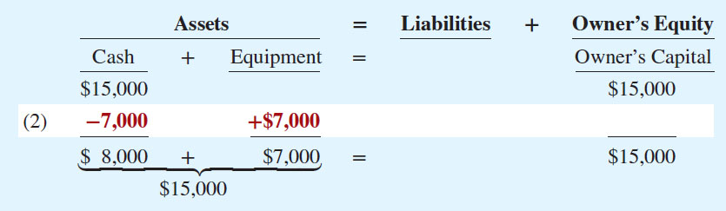
Transaction Analysis (2 of 10)
  Transaction 2. Softbyte purchases computer equipment for $7,000 cash.

Slide 21
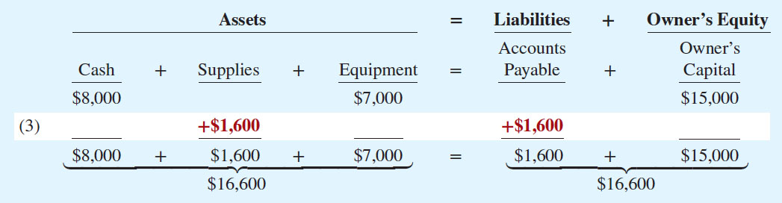
Transaction Analysis (3 of 10)
  Transaction 3. Softbyte Inc. purchases for $1,600 headsets and other computer accessories expected to last several months. The supplier allows Softbyte to pay this bill in October.

Slide 22
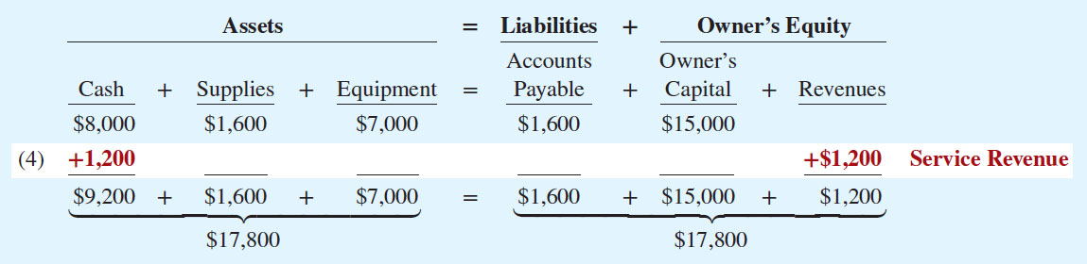
Transaction Analysis (4 of 10)
  Transaction 4. Softbyte receives $1,200 cash from customers for app development services it has performed.

Slide 23
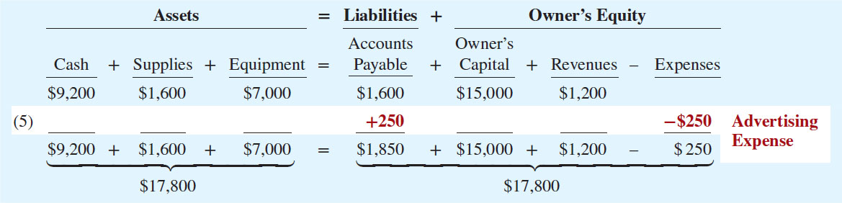
Transaction Analysis (5 of 10)
  Transaction 5. Softbyte Inc. receives a bill for $250 from the Daily News for advertising on its online website but postpones payment until a later date.

Slide 24
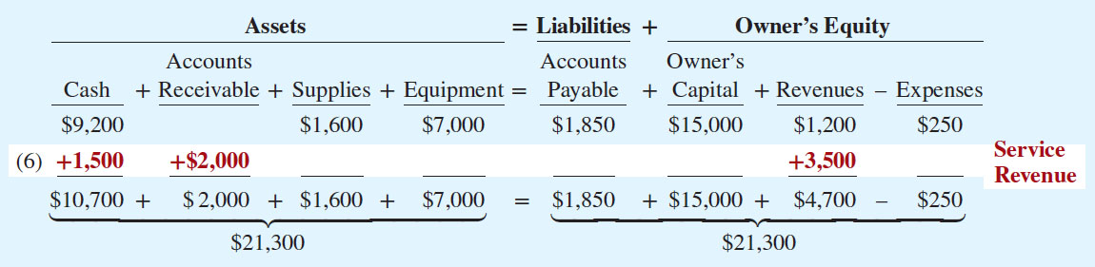
Transaction Analysis (6 of 10)
  Transaction 6. Softbyte performs $3,500 of app development services for customers. The company receives cash of $1,500 from customers, and it bills the balance of $2,000 on account.

Slide 25
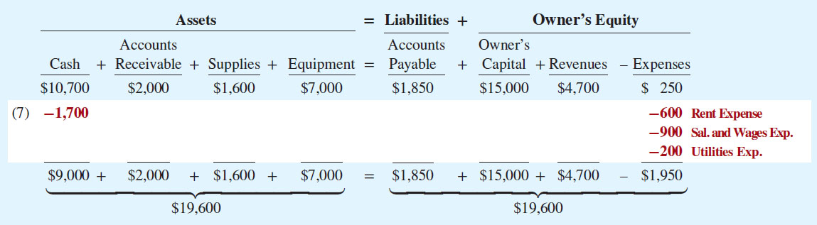
Transaction Analysis (7 of 10)
  Transaction 7. Softbyte pays the following expenses in cash for September: office rent $600, salaries and wages of employees $900, and utilities $200.

Slide 26
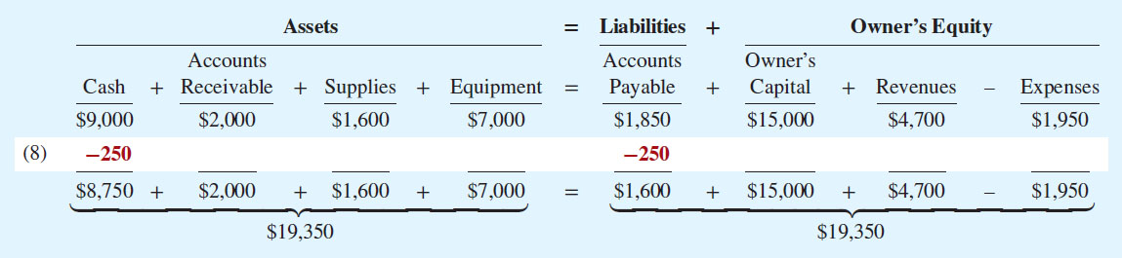
Transaction Analysis (8 of 10)
  Transaction 8. Softbyte pays its $250 Daily News bill in cash. The company previously (in Transaction 5) recorded the bill as an increase in Accounts Payable and a decrease in owner’s equity.

Slide 27
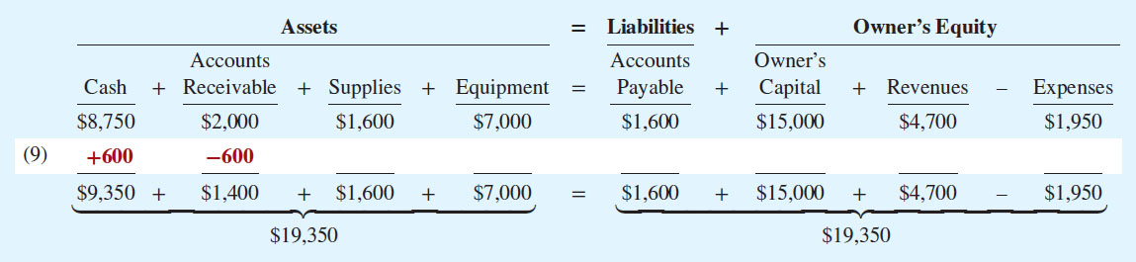
Transaction Analysis (9 of 10)
  Transaction 9. Softbyte receives $600 in cash from customers who had been billed for services (in Transaction 6).

Slide 28
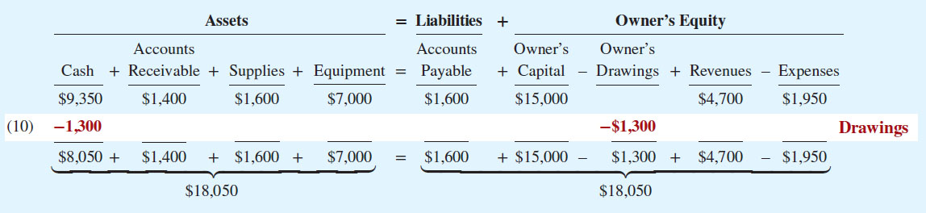
Transaction Analysis (10 of 10)
  Transaction 10. Ray Neal withdraws $1,300 in cash in cash from the business for his personal use.

Slide 29
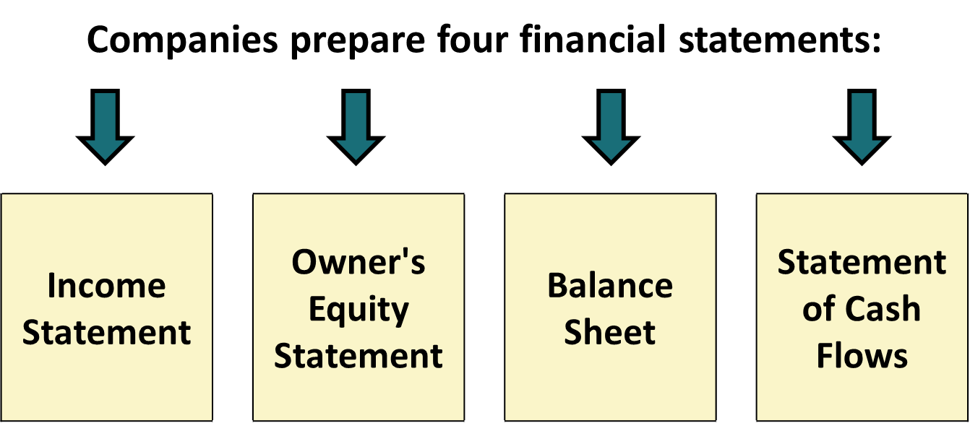
The Four Financial Statements

Slide 30
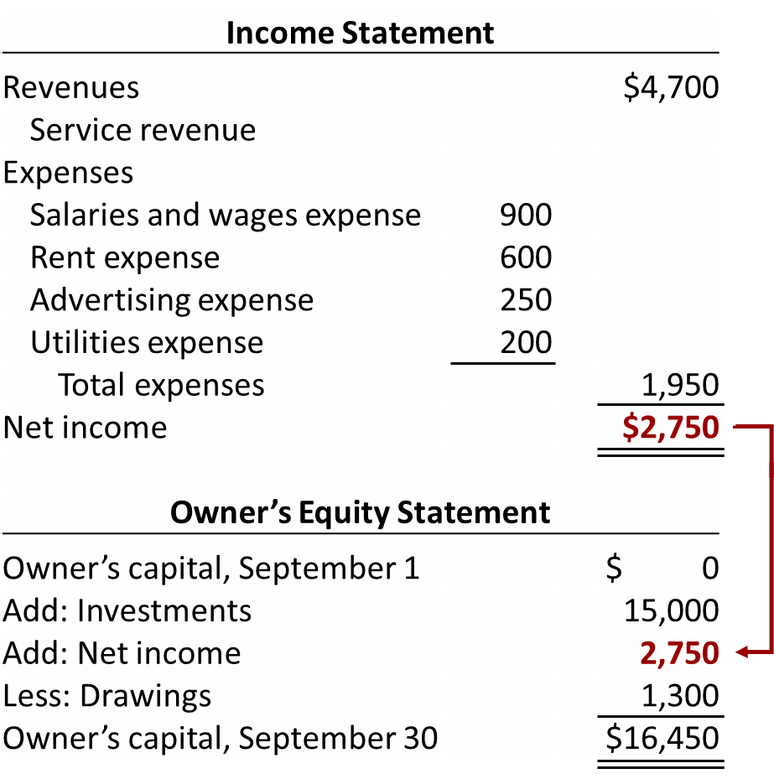
Financial Statements (3 of 7)
Softbyte statements for the Month Ended September 30, 2020

Slide 31
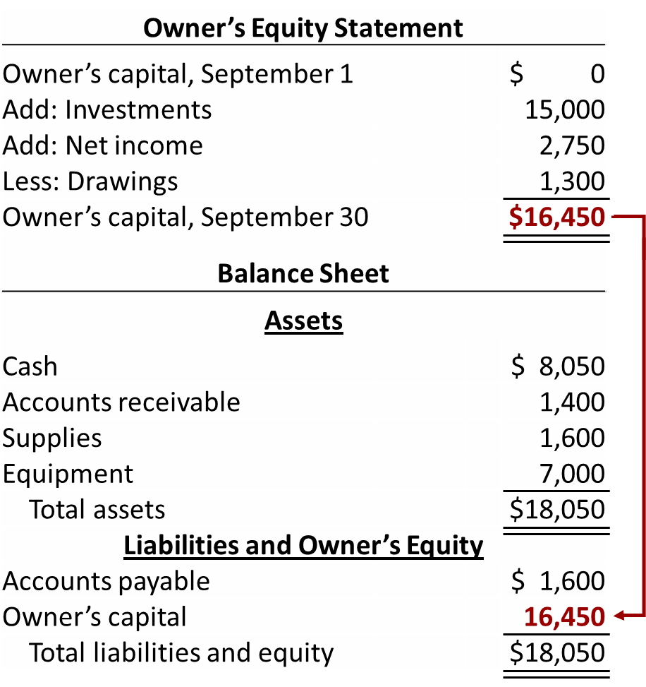
Financial Statements (4 of 7)
Softbyte statements for the Month Ended September 30, 2020

Slide 32
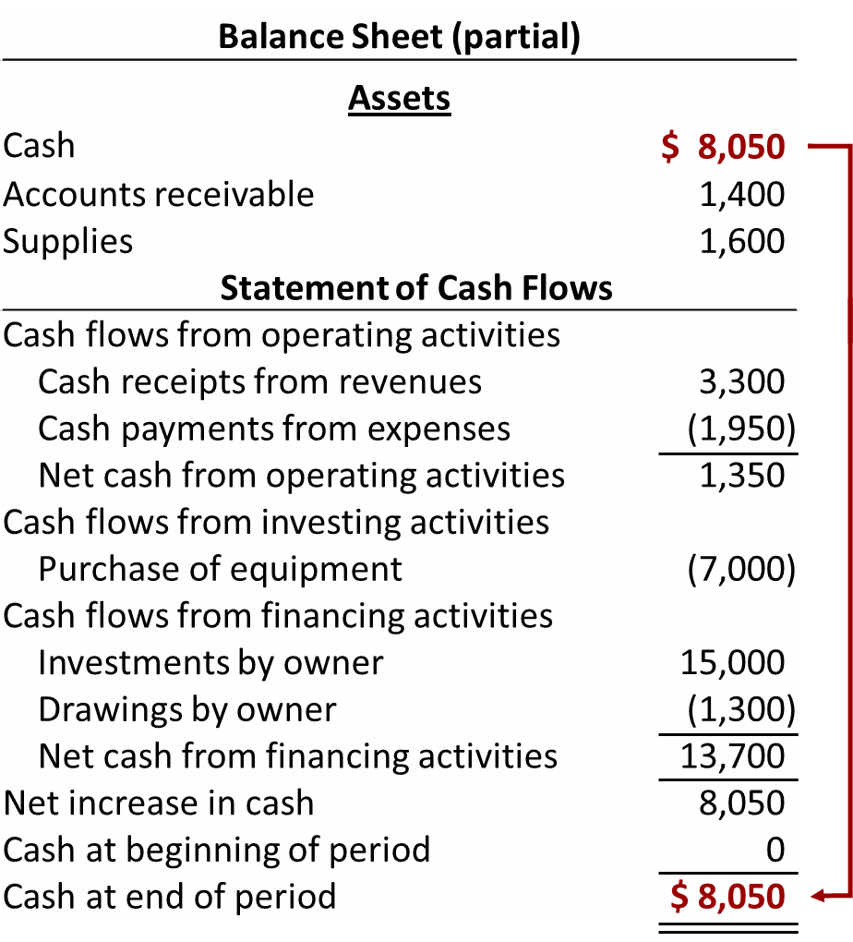
Financial Statements (5 of 7)
Softbyte statements for the Month Ended September 30, 2020

Slide 33
Income Statement
    Reports revenues and expenses for a specific period of time
    Lists revenues first, followed by expenses
    Shows net income (or net loss)

Slide 34
Owner’s Equity Statement
    Reports changes in owner’s equity for a specific period of time
    Time period is the same as that covered by the income statement

Slide 35
Balance Sheet
    Reports assets, liabilities, and owner’s equity at a specific date
    Lists assets at top, followed by liabilities and owner’s equity
    Total assets must equal total liabilities and owner's equity
    Snapshot of company’s financial condition at a specific moment in time (usually month-end or year-end)

Slide 36
Statement of Cash Flows
    Provides information on cash receipts and payments for a specific period of time
    Answers the following:
    Where did cash come from during the period?
    What was cash used for during the period?
    What was the change in the cash balance during the period?

Slide 37
Usefulness of the Statement of Cash Flows
    Provides information to help assess:
    Entity’s ability to generate future cash flows.
    Entity’s ability to pay dividends and meet obligations.
    Reasons for difference between net income and net cash provided (used) by operating activities.
    Cash investing and financing transactions during the period.

Slide 38
